Slide 1
Meet the Trainers
Angela Chew, LCSW, Clinical Director
Tonya Wolfe, LCSW, Clinical Director of Children’s Services
Tana Smith, BS, Program Director of Children’s Prevention Services
Sara Warmbrodt, MS, CMHP, Program Director of Family Based Mental Health
Amanda Carpin Straub, PsyD, Clinical Psychologist

Slide 2
Agenda:
12:45pm – 1:00pm: Introductions and Activity
1:00pm – 2:15pm: Trauma Presentation
2:15pm – 2:45pm: Pro-QOL Results and Self Care

Slide 3
Trauma: An Intro

Slide 4
Objectives
Discuss Trauma in terms of symptoms, presentation, and potential behaviors and how they may present in a school/classroom setting
Review signs of the different types of abuse and neglect
Provide strategies for helping
Provide interactive examples and case studies with discussion
Provide opportunity to discuss scenarios and answer any questions

Slide 5
Things to Keep in Mind
We will be discussing difficult topics
It’s okay to not be okay
Self-care, self-care, self-care! (more on this later today)
Notes:
1. If you feel that you need to take a break, feel free to step outside
2. You only have to share as much as you are comfortable with
3. We are here for you if you need to talk
4. Some of these topics may invoke strong feelings… that’s okay!
5. Self-care is VERY important. So important that we are spending 30 –minutes on the topic later today!

Slide 6
What is Trauma?
Definition (SAMHSA):
Result from event or series of events or set of circumstances that is experienced by an individual as physically or emotionally harmful or life-threatening and that has lasting adverse effects on the individual’s functioning and mental, physical, social, emotional, and/or spiritual well-being
Deeply distressing or disturbing experience
Trauma is individual, based on experience
Effected by past experiences, relationships and experience to current trauma
Can be a direct or indirect experience
Perceived threat
Helper relationships impacted
On a continuum and is often cumulative

Slide 7
Trauma Continuum
Non-Traumatic (t) Traumatic (T)
Perception of Event
None “T” (Paralyzing)
Degree of Trauma
Notes:
Nick

Slide 8
Types of Trauma
Acute Trauma
Complex/Chronic Trauma
Vicarious Trauma
Notes:
Acute Trauma – Events that occur at a particular time or place and are typically short lived (i.e. shooting, car accident, loss of loved one)
Complex/Chronic Trauma – prolonged exposure to traumatic events or experiencing multiple traumatic events that build on one another
Vicarious Trauma - an ongoing process of change over time that results from witnessing or hearing about other people’s suffering and need. When you identify with the pain of people who have endured terrible things, you bring their grief, fear, anger, and despair into your own awareness and experience.

Slide 9
Examples of Acute Trauma
Natural disaster
Car accident
Sudden death or loss of loved one
School violence
Burglary/crime victimization
Intensive medical procedure
Rape (single event)

Slide 10
Examples of Complex/Chronic Trauma
Physical abuse
Emotional abuse
Sexual abuse
Bullying/harassment
Neglect
Inadequate caregiving
Exposure to domestic violence

Slide 11
Examples of Vicarious Trauma
Seeing distressing videos repeatedly on TV
Hypervigilance when in an environment that reminds you of a trauma someone else experienced

Slide 12
That’s a Trauma?
Living in a chronically chaotic environment in which housing and financial resources are not consistently available
Homelessness
Frequent changes in caregivers (especially for young children)
Significant mental health issues in parents
Addiction in parents
Notes:
These are some examples of things that you might not think of as being traumatic…
Several others, this list could go on and on. It’s all about the person’s perceived experience of the threat and past experiences.

Slide 13
Factors to Consider in a Trauma
Severity of traumatic experience
Proximity to the event
Caregiver’s reaction
Prior history of trauma
Family and community factors

Slide 14
Symptoms of Trauma
AFFECTIVE SYMPTOMS
PHYSIOLOGICAL SYMPTOMS
Fear
Sadness
Anger
Anxiety
Dysregulated emotions
Irritability
Difficulties with concentration
Sleep difficulties
Anger outbursts
Impulsivity
Reckless behavior
Notes:
Dysregulate Emotions- rapidly changing emotions. Emotional Reactions that seem disproportionate to the situation.

Slide 15
Symptoms of Trauma (cont)
COGNITIVE SYMPTOMS
BEHAVIORAL SYMPTOMS
Irrational or erroneous beliefs
Reduced trust
Negative self-image
Accurate but unhelpful thoughts
Avoidance
Maladaptive behaviors
Sexualized behaviors
Violent behaviors
Temper tantrums
Substance abuse
Self-injury
Notes:
Kids may subtly blame themselves for traumatic experiences
It is not that we miss the symptoms- we often fail to put them together to see the BIG PICTURE
Often symptoms mimic other things like ADHD, ODD, Mood disorders etc.

Slide 16
ACES Study: An Overview
Adverse Childhood Experiences Study
Interested in why the drop out rate was so high in an obesity clinic at Kaiser Permanente during 1980s
Took place in 1995-1997
Conducted by Kaiser Permanente and the CDC
Over 17,000 participants
Participants were surveyed about physical abuse, sexual abuse, emotional abuse, physical neglect, emotional neglect, exposure to domestic violence, household substance abuse, household mental illness, parental separation or divorce, and an incarcerated household member
Long-term studies are still ongoing; several follow-up studies

Slide 17
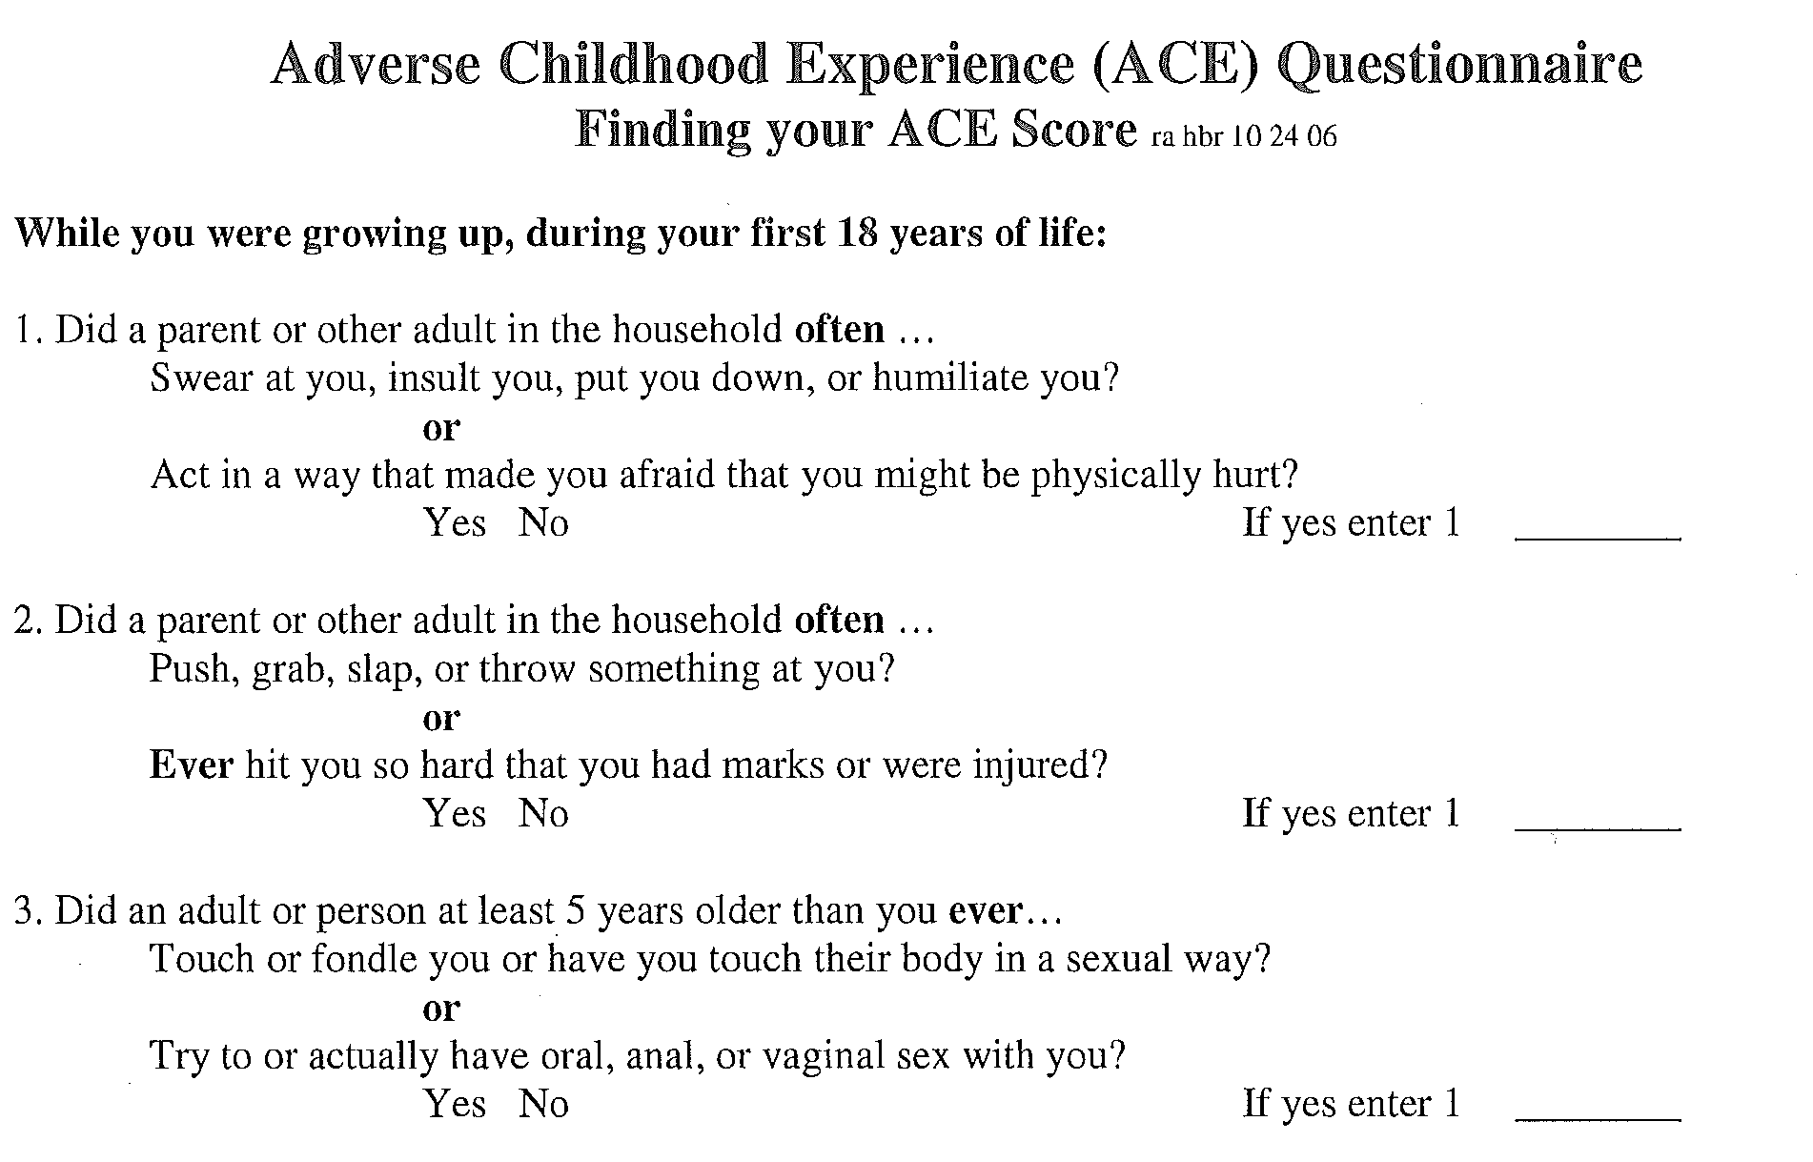

Slide 18
ACES: Outcomes
2 out of 3 of people reported at least one ACE
More than 1 out of 5 people reported two or more ACES
Short- and long-term outcomes of these childhood exposures include a multitude of health and social problems
Compared to an ACE score of zero, having 4 adverse childhood experiences was associated with a seven-fold (700%) increase in alcoholism, a doubling of risk of being diagnosed with cancer, and a four-fold (400%) increase in emphysema
Compared to an ACE score of zero, having 6 adverse childhood experiences was associated with a 30-fold (3000%) increase in attempted suicide

Slide 19
ACES Outcomes
The more ACES a person has, the more likely they are to experience…
Alcoholism and alcohol abuse
Chronic obstructive pulmonary disease (COPD)
Depression, anxiety, and other mental health diagnoses
Fetal death
Health-related quality of life
Illicit drug use and addiction
Ischemic heart disease (IHD)
Liver disease
Multiple divorces
Auto-immune disease
Lung cancer
Skeletal fractures
Risk for intimate partner violence: perpetrator and victimization
Multiple sexual partners
Sexually transmitted diseases (STDs)
Smoking
Suicide attempts
Unintended pregnancies
Early initiation of smoking
Early initiation of sexual activity
Adolescent pregnancy
Diabetes
Work problems: absenteeism, productivity, work-related injuries

Slide 20
Facts About Trauma
2/3 Americans have experienced a trauma by the time he/she is 16 years old
2/3 of those children will recover on their own, without the need for intervention
1/3 will struggle if they do not get treatment, which can lead to further physical health complications.
1 out of every 4 children in the US have been exposed to a traumatic event which can effect learning and behavior
71% of children exposed to violence each year (Finklehor, et al, 2013)
3 million children maltreated or neglected each year (Child Welfare Info. Gateway. 2013)
1 in 4 girls and 1 in 6 boys are sexually abused before adulthood (NCTSN, 2009)
75-93% of youth entering the juvenile justice system have experienced trauma (Justice Policy Institute, 2010)
92% of youth in residential and 77% in non-residential report multiple traumatic events (NCTSN, 2011)
84%+ of adult mental health clients have trauma histories (Meuser et al., 2004)
Up to 65% of all clients in substance abuse treatment report childhood abuse (SAMHSA, 2013)

Slide 21
Video: 911 Call
https://www.youtube.com/watch?v=u-7J5akhSA8

Slide 23
What You Might See in the School Setting
IMPAIRMENT IN LEARNING
INCREASED PHYSICAL AND EMOTIONAL DISTRESS
Lower grades
Increased absences
Negative affects to attention, memory and cognition
Reduced ability for child to focus, organize and process information
Interference with effective problem-solving and/or planning
Increased feelings of frustration and anxiety
Thinking others are violating their personal space
Outbursts when being corrected or told what to do by an authority figure
Fighting when being criticized or teased by others
Resisting transition and/or change

Slide 24
Categories of Child Abuse
Bodily Injury
Serious Mental Injury
Sexual Abuse and Exploitation
Serious Physical Neglect
Likelihood of serious bodily injury or sexual abuse
Medical child abuse
Per se Definitions
Notes:
We are going to cover behavioral indicators of the first four- as they are things that you will be most likely to hear about or see indicators of.

Slide 25
Bodily Injury: Behavioral Indicators of Abuse
Withdrawn from others
No expectation of comfort
“Frozen watchfulness”
Fear of physical abuse
Clings to adults
Appears depressed or lacks emotion
Timid and easily frightened
Eager to please
Role reversal

Slide 26
Serious Mental Injury
Depression and absence of affect
Mental or emotional developmental delays
Self mutilation or other self-injurious behaviors
Suicide attempts
Compulsive disorders
Antisocial behavior, may include cruelty to children or animals
Delinquent behaviors
Alcohol or drug abuse
Extreme fearfulness

Slide 27
Sexual Abuse or Exploitation
PHYSICAL INDICATORS
BEHAVIORAL INDICATORS
Injury to the genitals
STD’s
Suspicious stains
Bladder or urinary tract infections
Painful bowel movements
Pregnancy
Verbal disclosure
Developmentally inappropriate sexual knowledge
Inappropriate sexual behavior
Lack of interest or involvement in activities
Layered or inappropriate clothing
Hiding clothing
Generalized emotional distress
Notes:
In PA most frequently the children who experience this type of abuse are between the ages of 10 and 14

Slide 28
Serious Physical Neglect
Failure to thrive
Delays in physical development
Unattended physical problems
Chronic truancy
Abandonment
Inappropriate caregivers
Positive toxicology

Slide 29
What Can You Do? Strategies for Helping in the School Setting
Maintain usual routines
Increase level of support and encouragement being given
Set clear; firm limits
Recognize behavioral problems may be related to trauma
Provide a safe place for the child to talk about what happened
Give simple and realistic answers to the child’s questions about a traumatic event
Be sensitive to the “triggers” in the environment that may cause a reaction to the traumatized child
Warn children if you will be doing something out of the ordinary
Notes:
Sensory activity????

Slide 30
Strategies continued….
Form connections
Teach students to recognize and name emotions
Model assertiveness skills
Give children choices
Check assumptions, observe and question
Be aware of other children’s reactions to the traumatized child and to the information they share
Understand that children cope by re-enacting trauma through play and through their interaction with others
Be attentive if the child experiences severe feelings, anger, guilt, shame or punishment
Work adaptations for a short period of time
CONTACT BEHAVIORAL HEALTH SERVICES TO PROVIDE YOU SUPPORT IN HOW TO BEST HELP YOUR STUDENTS

Slide 33
Self-Care is Important

Slide 34
ProQOL Results

Slide 35
Self-Care is Critical
Get rest
Eat properly
Move around and get brief exercise
Keep alcohol use to a minimum
Schedule time for self
Remember to laugh
Develop a ritual to clear your mind
Engage your family/friends/pets
Remember your switch
Ask for help

Slide 36
Laughter is …
Universal
Physical
Emotional
Social
Linguistic
Intellectual
Necessary
Notes:
hyenas, monkeys, kookaburra, frogs, woodpeckers, crows, doves, geese, gulls, falcons, owls…
hyenas, monkeys, kookaburra, frogs, woodpeckers, crows, doves, geese, gulls, falcons, owls…
Basic unit of matter = quarks

Slide 37
What happens when we laugh?
Heart rate increases
Blood pressure/circulation increases
Increased respiratory rate
Muscles contract and release to produce the laughter
Changes in attention
Reduction of pain
Reduction in stress related hormones
Increase natural (bad) cell killers

Slide 38
Benefits of Laughter
Research has not been done enough to indicate consistent outcomes other than that laughter has :
no side effects
no overdose risk
no cost
multi-systemic effects
compliments to medical and mental health interventions

Slide 39
Laughter Factory

Slide 40
Bubble Breath and Release

Slide 41
Relaxation can help (activity)

Slide 43
Contact Information
Angela Chew, LCSW, achew@dickinsoncenter.org
Tonya Wolfe, LCSW, twolfe@dickinsoncenter.org
Tana Smith, BS, tsmith@dickinsoncenter.org
Sara Warmbrodt, MS, CMHP, swarmbrodt@dickinsoncenter.org
Amanda Carpin Straub, PsyD, astraub@dickinsoncenter.org

Slide 44
Resources
https://traumaawareschools.org/traumainschools
https://www.maryscenter.org/sites/default/filesSBMH%20PPT%TEACHING%20TEACHERS%20VERSION2.pdf
https://www.weareteachers.com/10-things-about-childhood-trauma-every-teacher-needs-to-know/
https://www.nctsn.org/sites/deault/files/resources//childtraumatoolkiteducators.pdf
Recognizing and Reporting Child-Abuse-Training Guide for Mandated Reporters. (2015). Pennsylvania Family Support Alliance

